Slide 1
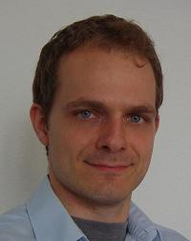



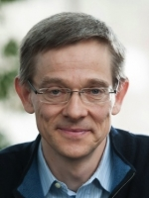







First International Workshop on Video Segmentation
Organizers:
Thomas Brox, University of Freiburg
Fabio Galasso, OSRAM Corp. Tech. Research, Max Planck Institute for Informatics
Fuxin Li, Georgia Institute of Technology
James Matthew Rehg, Georgia Institute of Technology
Bernt Schiele, Max Planck Institute for Informatics

Slide 2
Motivation
Fast growing interest
[Ochs and Malik, ECCV’10], [Vazquez-Reina et al. ECCV’10], [Lezama et al. CVPR’11], [Ochs and Brox ICCV’11], [Lee et al. ICCV’11], [Godec et al. ICCV’11], [Sundaram et al. ICCV’11], [Fragkiadaki and Shi CVPR’12], [Xu and Corso CVPR’12], [Ma and Latecki CVPR’12], [Dragon et al. ECCV’12], [Lee et al. ECCV’12], [Xu et al. ECCV’12], [Zhang et al. CVPR’13], [Chang et al. CVPR’13], [Palou and Salembier CVPR’13], [Tang et al. CVPR’13], [Reso et al. ICCV’13], [Papazoglou and Ferrari ICCV’13], [Van den Bergh et al. ICCV’13], [Banica et al. ICCV’13], [Li et al. ICCV’13], [Jain et al. ICCV’13], [Levinshtein et al. ACCV’10], [Maire and Yu ICCV’13], [Badrinarayanan et al. IJCV’13], [Rota Bulo‘ and Kontschieder CVPR’14], [Chang et al. CVPR’14], [Kae et al. CVPR’14], [Galasso et al. CVPR’14] [Jain and Grauman ECCV’14], [Wang et al. ECCV’14]…
Notes:
As the first workshop on this topic, we organizers feel like we should use a short opening to give a bit of background information on this topic

Slide 3
Diverse Problem Statements
Separating one foreground from the background [Papazoglou and Ferrari ICCV’13], [Zhang et al. CVPR’13], [Van den Bergh et al. ICCV’13]
Multiple object segmentation [Vazquez-Reina et al. ECCV’10], [Lee et al. ECCV’12], [Li et al. ICCV’13]
Identifying moving objects [Fragkiadaki and Shi CVPR’12], [Lezama et al. CVPR’11], [Ochs and Brox ICCV’11], [Dragon et al. ECCV’12]
Defining an over-complete supervoxel representation [Chang et al. CVPR’13], [Reso et al. ICCV’13], [Xu and Corso CVPR’12]
Computing hierarchical sets of coarse-to-fine video segmentations [Levinshtein et al. ACCV’10], [Palou and Salembier CVPR’13], [Sundaram et al. ICCV’11], [Xu et al. ECCV’12], [Maire and Yu ICCV’13], [Jain et al. ICCV’13], [Galasso et al. CVPR’14]
Ranking segmentation proposals [Banica et al. ICCV’13], [Lee et al. ICCV’11], [Ma and Latecki CVPR’12], [Zhang et al. CVPR’13]
Unsupervised/supervised, semi-automatic, interactive [Badrinarayanan et al. IJCV’13], [Godec et al. ICCV’11], [Tang et al. CVPR’13]
Semantic segmentation [Rota Bulo‘ and Kontschieder CVPR’14], [Chang et al. CVPR’14], [Kae et al. CVPR’14]
Notes:
Correspondence on a fine-grained level
compatible

Slide 4
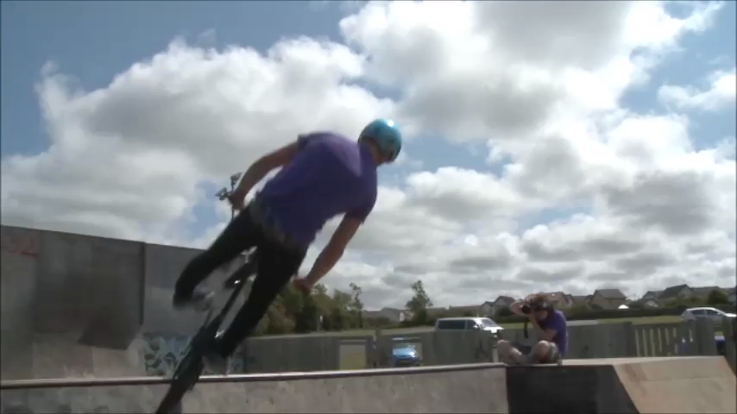

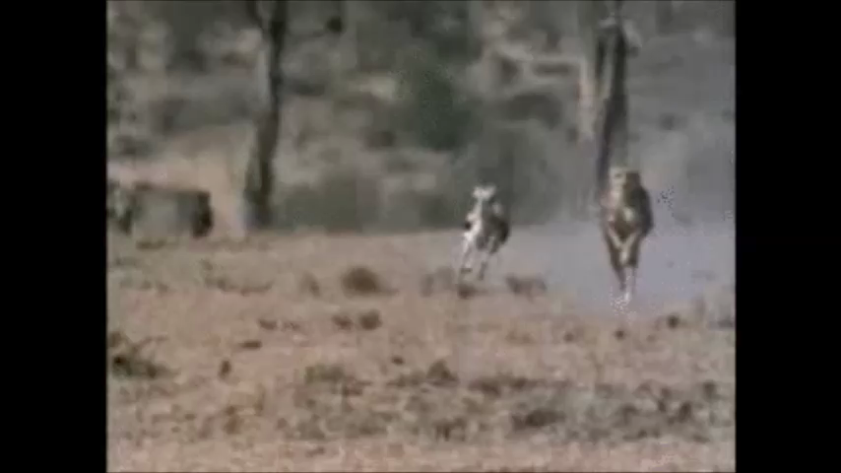
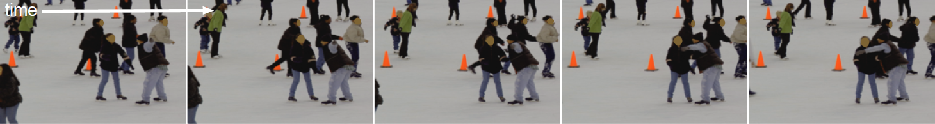
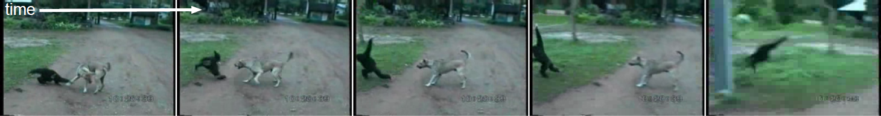
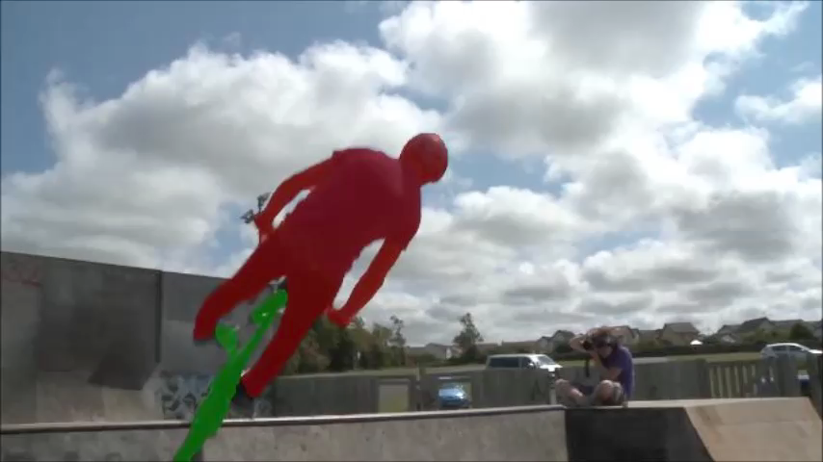

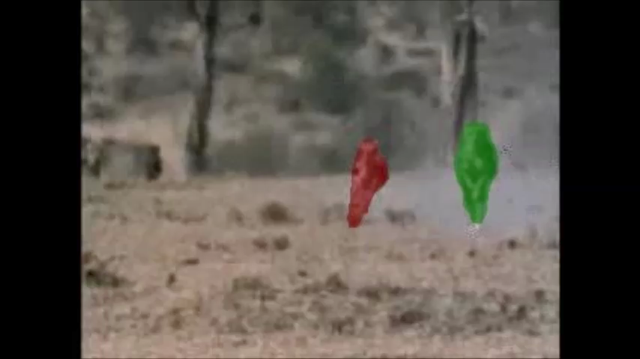
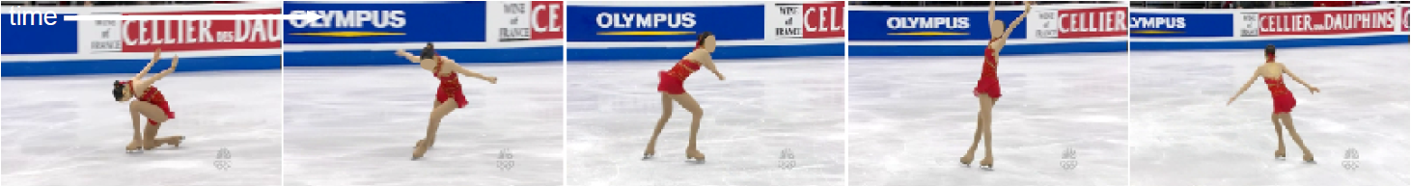

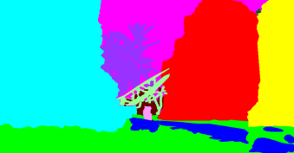

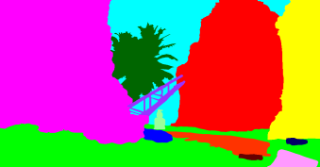

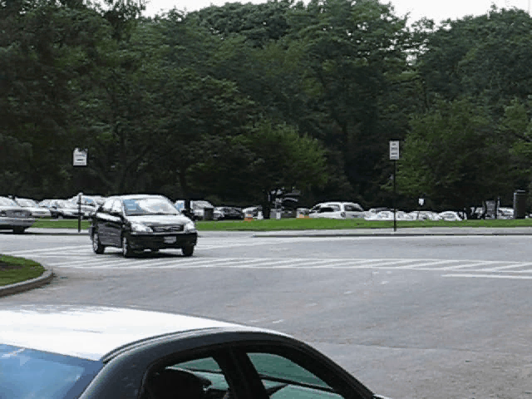
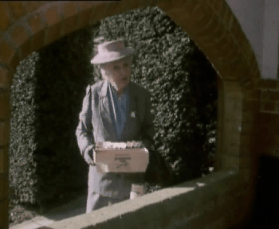



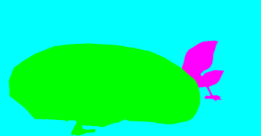



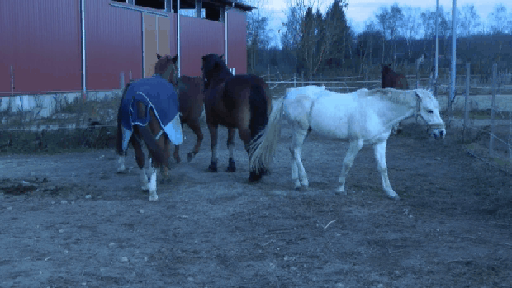
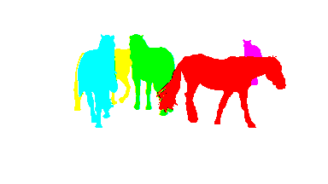
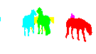

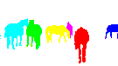


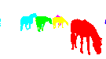








Motivation
And different benchmarks
SegTrack v2
LIBSVX
VSB100
FBMS
…
Notes:
Benchmarks have different evaluation measures.
We picked four different benchmarks to showcase how different their aims are.

Slide 5
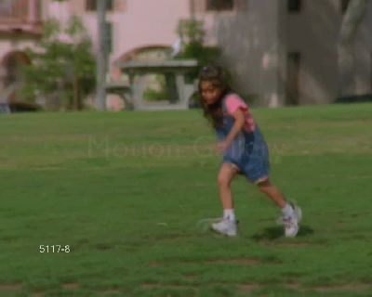
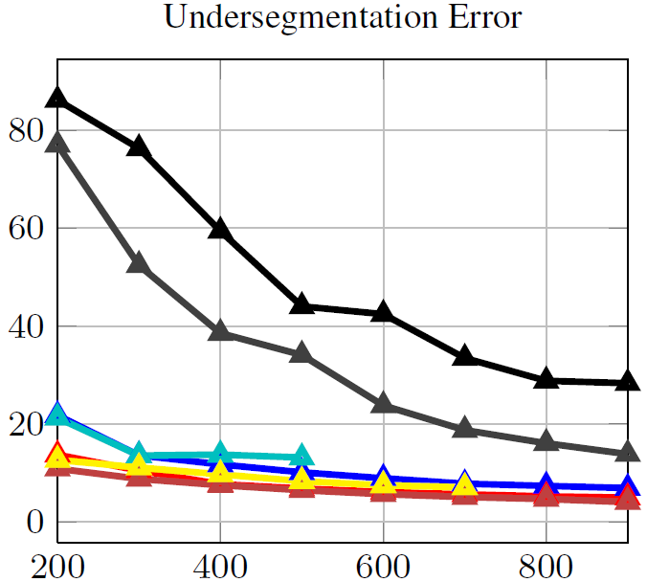
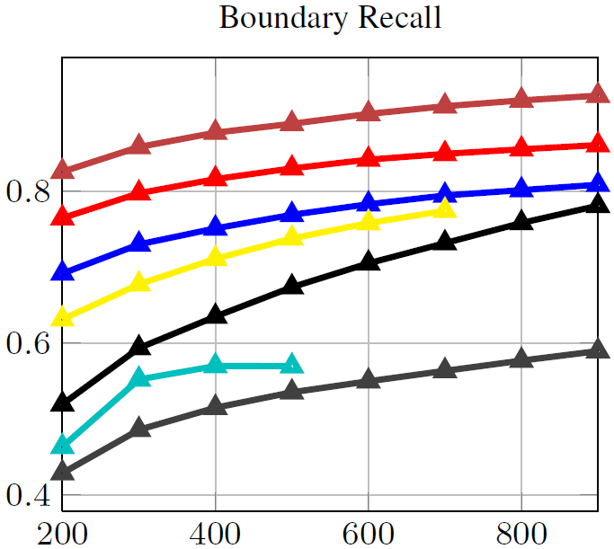
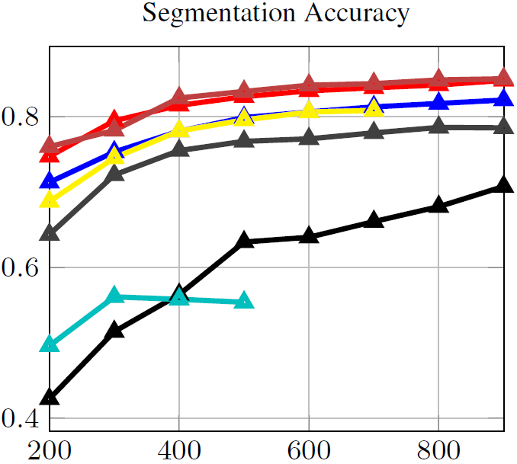
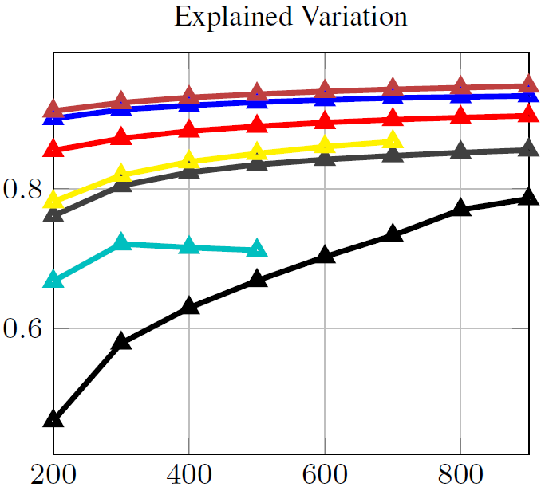
LIBSVX [Xu and Corso CVPR’12]
Supervoxel segmentation
Spatio-temporally uniform
Accurate at boundaries
Parsimonious
Corresponding metrics

Slide 6
Motivation
And different benchmarks
SegTrack v2
LIBSVX
VSB100
FBMS
…

Slide 7
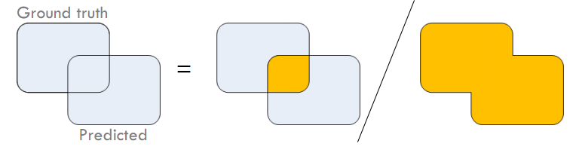
SegTrack v2 [Li et al. ICCV’13]
(Video) Multiple Objects
Annotations for each frame
Videos for different challenges: motion blur, appearance change, deformation etc.
Intersection over Union for best many-to-one match
Notes:
Don’t care much about the background
Different adjacent objects as different entities.

Slide 8
Motivation
And different benchmarks
SegTrack v2
LIBSVX
VSB100
FBMS
…

Slide 9

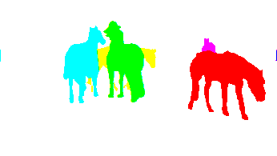
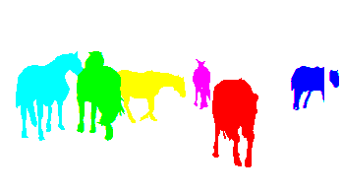

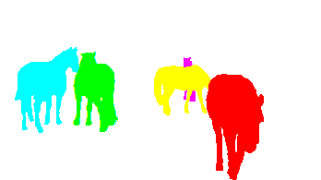
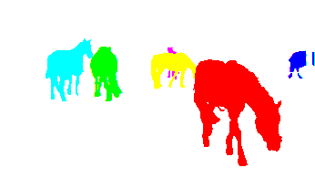

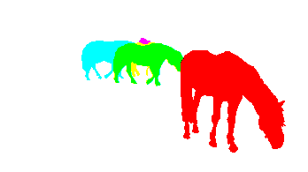
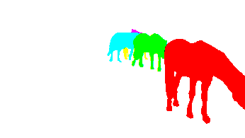

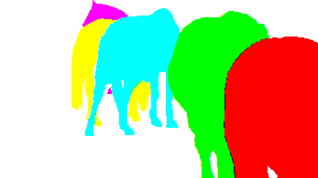
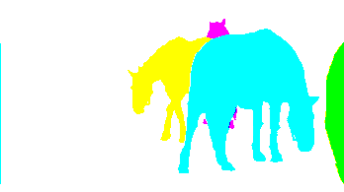
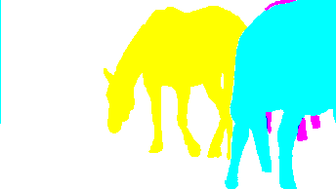
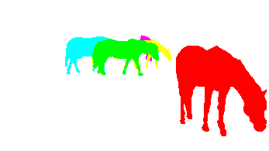

FBMS [Ochs et al. TPAMI’14]
Motion segmentation
59 videos of diverse length and resolution
Best one-to-one match and precision-recall
…
Notes:
The idea is to produce a single, consistent segmentation which contains each object as a different segment. And accuracy is measured using the best one-to-one match from the segmentation to the ground truth using a Hungarian algorithm in a precision-recall framework.

Slide 10
Motivation
And different benchmarks
SegTrack v2
LIBSVX
VSB100
FBMS
…

Slide 11



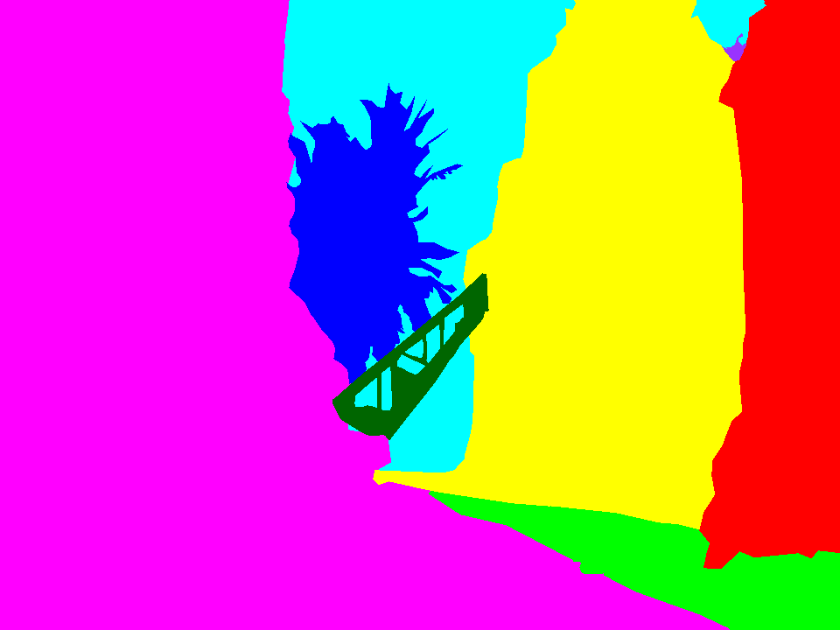

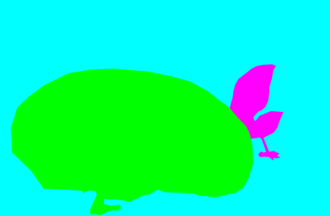


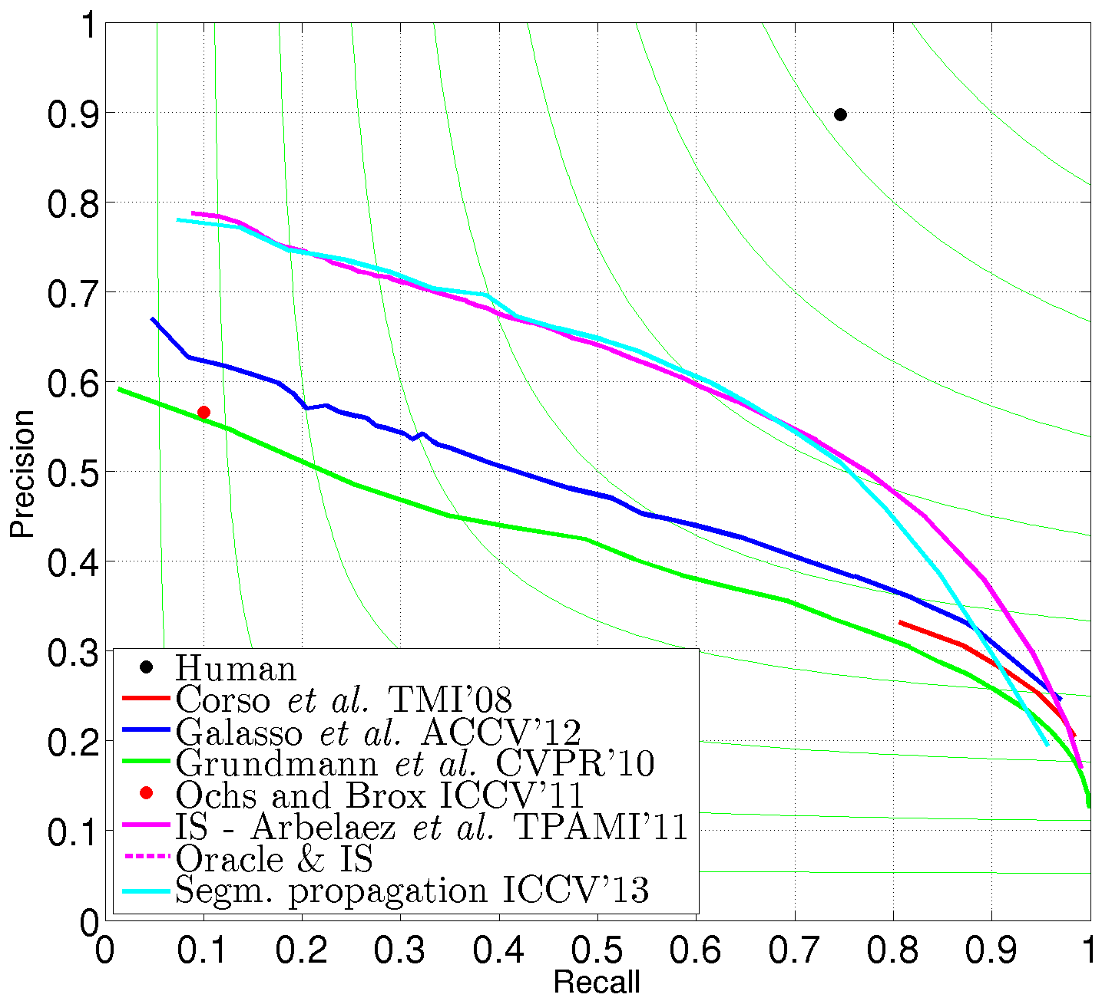
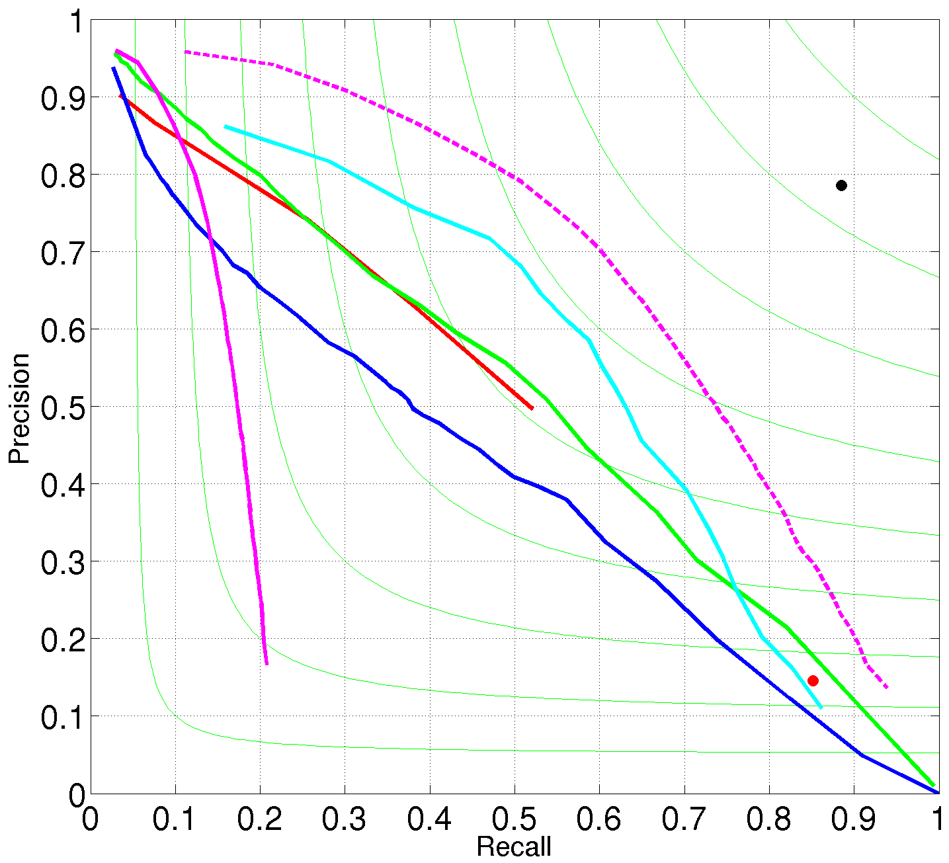
VSB100 [Galasso et al. ICCV’13]
Multiple human annotations
Video seg
Image seg
Baseline
Boundary Precision-Recall
Volume Precision-Recall
Notes:
If the task is unspecified as a general video segmentation task, then there is an ambiguity of the correct level of granularity on the ground truth segments, and different human annotators would show different acceptable ways to segment the video. And one can see the agreement among the human annotators are around 80%-90% percent. Especially, they tend to agree on the main subjects but differ on the background ones.
It unifies video and image segmentation benchmark together and allows the testing of coarse-to-fine methods because it
Simple baseline like image segmentation + optical flow actually outperforms all the tested video segmentation methods.

Slide 12
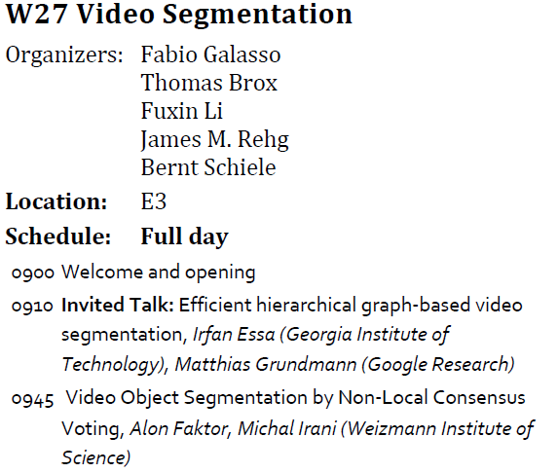
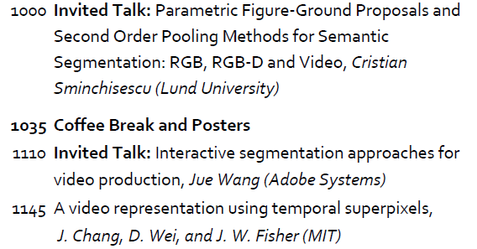
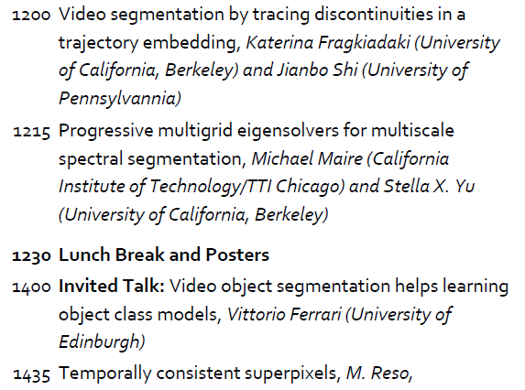
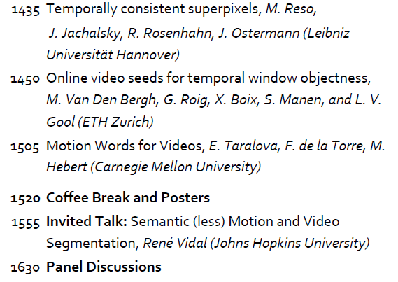
Today
Dense full day program
5 Invited speakers
7 short talks
Poster at lunch and coffee breaks
Posters behind the room
Short presentation by Michael Black
Panel discussion: 4:30PM
All invited speakers are invited to the panel
Notes:
Short talks have been great previously published work… It has been chosen because it expresses state-of-the-arts of the video segmentation problem.
Poster
Posters at lunch and coffee breaks.
We’re going to have the most important thing in the end so you must stay.

